Slide 1


Exception handling

Slide 2
Contents
What is an exception?
Categories of exceptions
Example project
Catch wrong user input by catching the unchecked exception
Development of user-defined exception in REST service:
1. Create Custom Error Response class
2. Create Custom Exception class
3. Update REST Service to throw Exception
4. Add Exception Handler with @ExceptionHandler
Global Exception Handling with @ControllerAdvice

Slide 3
What is an exception?
An exception is a problem that arises during the execution of a program. When an Exception occurs the normal flow of the program is disrupted and the program/Application terminates abnormally, which is not recommended, therefore, these exceptions are to be handled.
An exception can occur for many different reasons. Following are some scenarios where an exception occurs:
a user has entered an invalid data.
a file that needs to be opened cannot be found.
a network connection has been lost in the middle of communications or the JVM has run out of memory
Some of these exceptions are caused by user error, others by programmer error, and others by physical resources that have failed in some manner.
Based on these, we have 2 categories of built-in Exceptions:
Checked exceptions
Unchecked exceptions

Slide 4
Checked <-> Unchecked exceptions
Checked Exceptions simply means that these exceptions require us to specify at compile time how the application will behave in case the exception occurs. We must anticipate in the code how to recover from the error e.g., with a try-catch-block
The unchecked exceptions do not mandate compile time handling from us. Such exceptions occur at the time of execution. These are also called Runtime Exceptions. These include programming bugs, such as logic errors or improper use of an API. Runtime exceptions are ignored at the time of compilation.
Spring prefers unchecked exceptions because
“checked exceptions requires handling, result in cluttered code and unnecessary coupling”
“checked exceptions break the Open/Closed principle, since a change in the signature with a new throws declaration could have effects in many levels of our program calling the method”

Slide 5
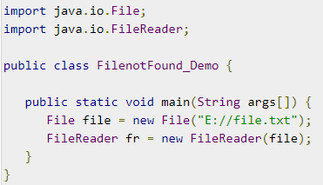
Checked exceptions - example
A checked exception is an exception that is checked by the compiler at compilation-time, these are also called compile time exceptions. These exceptions cannot simply be ignored, the programmer should take care of (handle) these exceptions
For example, if you use FileReader class in your program to read data from a file:
If the file specified in its constructor doesn't exist, then a FileNotFoundException occurs. The compiler prompts the programmer to handle the exception. An error is thrown at compile-time and you will not be able to run the program!
How to handle a checked exception as a programmer?
Method 1: Declare the exception using throws keyword.
> public static void main(String args[]) throws FileNotFoundException{…}
Disadvantage: when the file is not found at runtime an ugly error (FileNotFoundException) will be thrown at the user
Method 2: Handle it using a try-catch block
try{ File file = new File(“E://file.txt”); FileReader fr = new FileReader(file); }catch(FileNotFoundException fnfe){ System.out.println("The specified file is not present at the given path"); }
Advantage: the user gets a meaningful error message

Slide 6
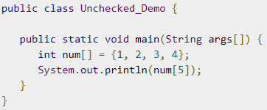
Unchecked exceptions – example
An unchecked exception is an exception that occurs at the time of execution. These are also called Runtime Exceptions. These include programming bugs, such as logic errors or improper use of an API. Runtime exceptions are ignored at the time of compilation.
For example, if you have declared an array of size 5 in your program and trying to call the 6th element of the array then an ArrayIndexOutOfBoundsExceptionexception occurs.
The above program will compile, but when you run this program, you will get this error:
NullpointerException is also an example of an unchecked exception
We can handle unchecked exceptions with a try-catch block, just like checked exceptions but that is only a good idea when the exception happens due to wrong user input. Often unchecked exceptions are caused by programming errors. Then, of course, the idea is to fix the programming error and not to introduce a try-catch block.

Slide 7
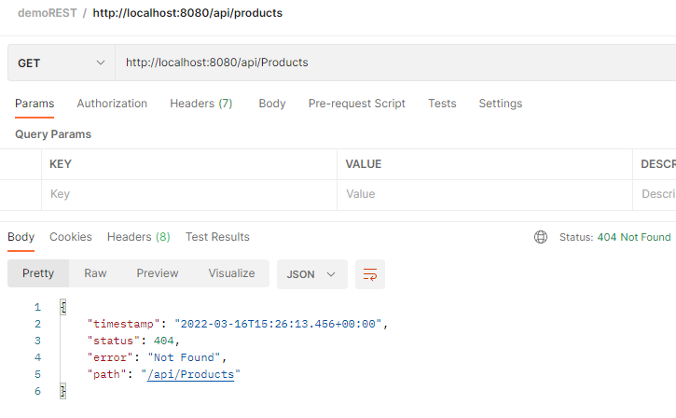
Unchecked Exception - example
The path does not exist (capital letter is used…) => this creates an unchecked exception => HTTP 404
The body of this exception

Slide 8
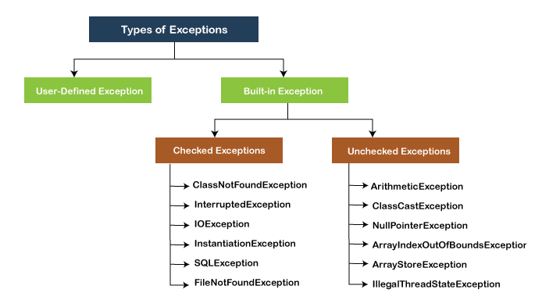
Categories of exceptions
in addition to built-in exceptions, we can also make our own User-Defined exceptions. That’s what we are going to do in this lesson.

Slide 9
Contents
What is an exception?
Categories of exceptions
Example project
Catch wrong user input by catching the unchecked exception
Development of user-defined exception in REST service:
1. Create Custom Error Response class
2. Create Custom Exception class
3. Update REST Service to throw Exception
4. Add Exception Handler with @ExceptionHandler
Global Exception Handling with @ControllerAdvice

Slide 10
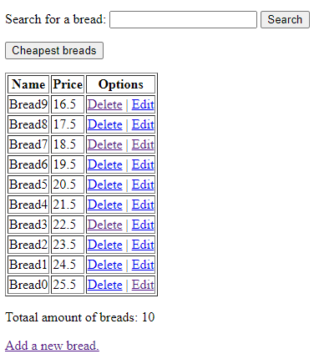
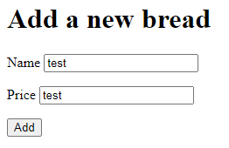
Example project
In this presentation, we will start from exampleProject-jpa from “Lesson 3 JPA, Keyword Queries & JPQL”. We run the project and try to add a new bread with name “test” and price “test”

Slide 11
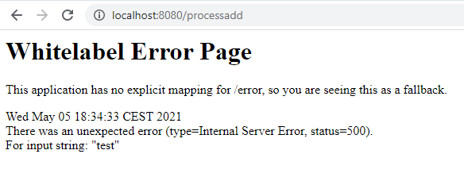
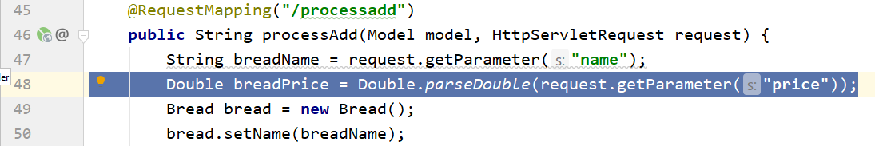
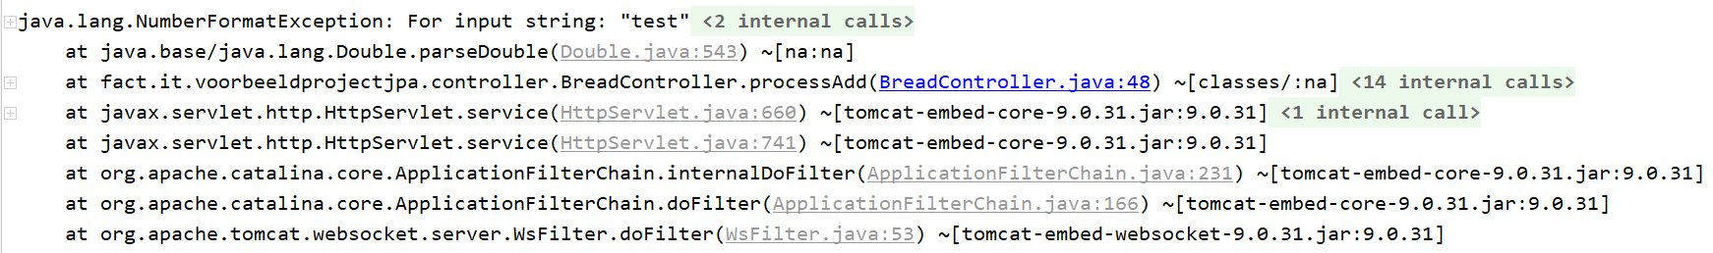
Example project
What happened?
A NumberFormatException is thrown at line 48 of our Breadcontroller!
In HTML:
In IntelliJ console :

Slide 12
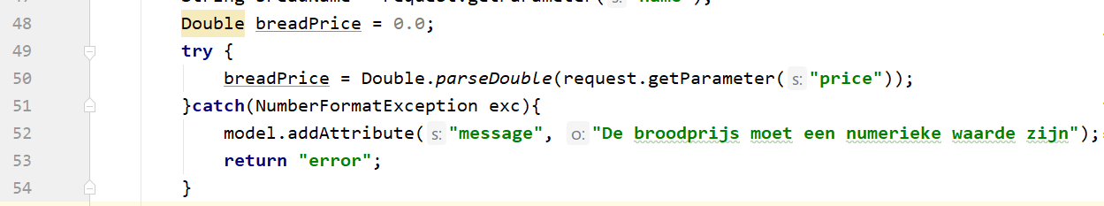
Example project: unchecked exception
The NumberFormatException on the previous slide was caused by incorrect user input (a textual value was passed instead of a numerical value) and not a programming error.
We want to give the user a nice error message that indicates exactly what is going on.
To do that we use a try-catch block around the piece of code that generates the exception:

Slide 13
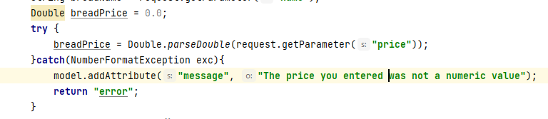
Example project: try-catch
The try statement allows you to define a block of code to be tested for errors while it is being executed.
In this case we test if we can convert the price parameter to a double
The catch statement allows you to define a block of code to be executed, if an error occurs in the try block.
In this case: if we get an error converting the price to a double we want to return an error page with the message “De broodprijs moet een numerieke waarde zijn”

Slide 14
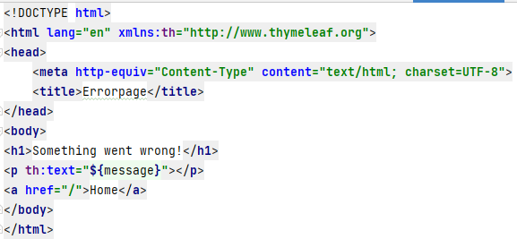
Example project: error page
To be able to show the error message to the user we make an error page: error.html

Slide 15
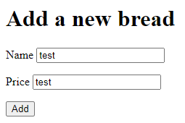
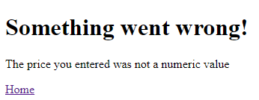
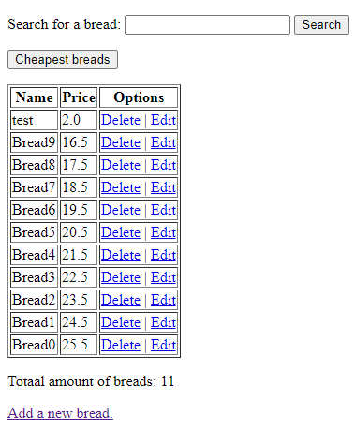
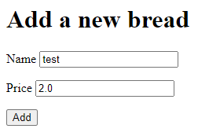
Test the example project
It works!

Slide 16
Contents
What is an exception?
Categories of exceptions
Example project
Catch wrong user input by catching the unchecked exception
Development of user-defined exception in REST service:
1. Create Custom Error Response class
2. Create Custom Exception class
3. Update REST Service to throw Exception
4. Add Exception Handler with @ExceptionHandler
Global Exception Handling with @ControllerAdvice

Slide 17
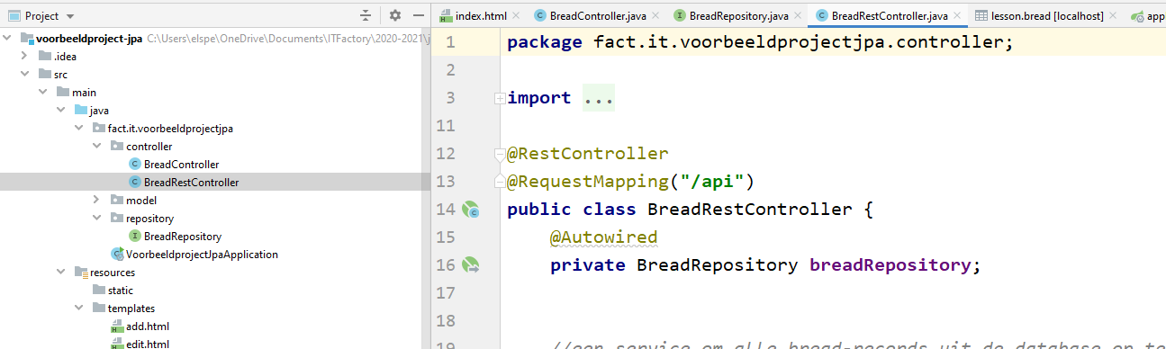
Example project
Now we will elaborate on the BreadRestController code.

Slide 18
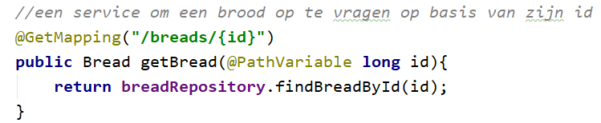
Exception handling
We will create a new API endpoint to retrieve a single bread by id. For that we add the following code to BreadRestcontroller:
In breadRepository we add this method:

Slide 19

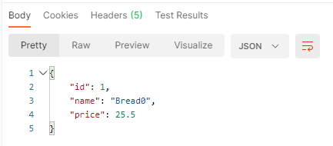

Exception handling
We test our new API endpoint with Postman
What happens if the user inputs a non-existent id?
Status: 200 OK? This response doesn’t look ok to me! What’s going on?
Empty?
What’s the problem?
Why don’t I get bread?

Slide 20

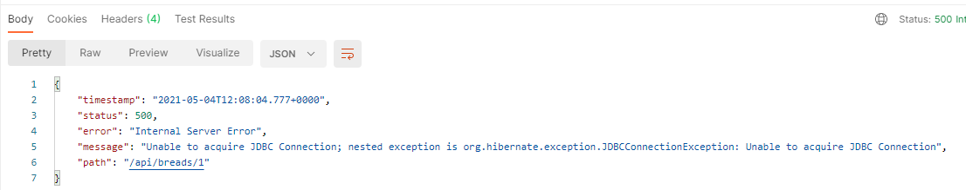
Exception handling
What happens if we shut down the MySQL database server?
When a built-in unchecked exception occurs, we get a JSON formatted error message + the status code is changed.
Status: 500 Something went seriously wrong…
Error message formatted as JSON

Slide 21
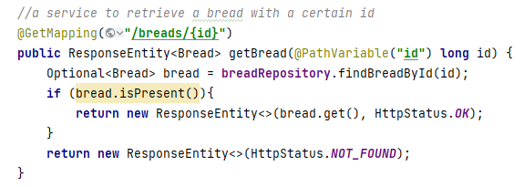
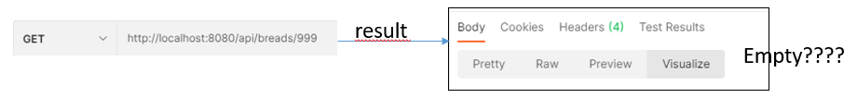
Exception handling
Suppose we want to have a service to retrieve a bread with a certain id:
When no bread with the given id is found, we get an empty return:

Slide 22
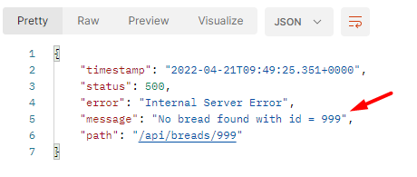
Exception handling
When no bread with the given id is found, we want to throw our own exception instead of the null return
Desired output: error formatted as JSON, just like the connection error but with a customised message:

Slide 23
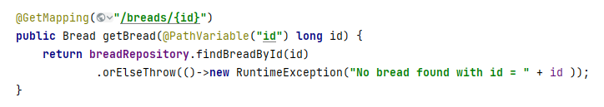
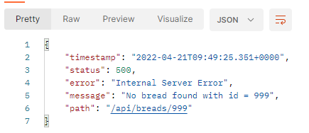
Exception handling
Instead of returning an Optional the service has to return a Bread-object:
When no bread with the given id is found, we now get this output:

Slide 24
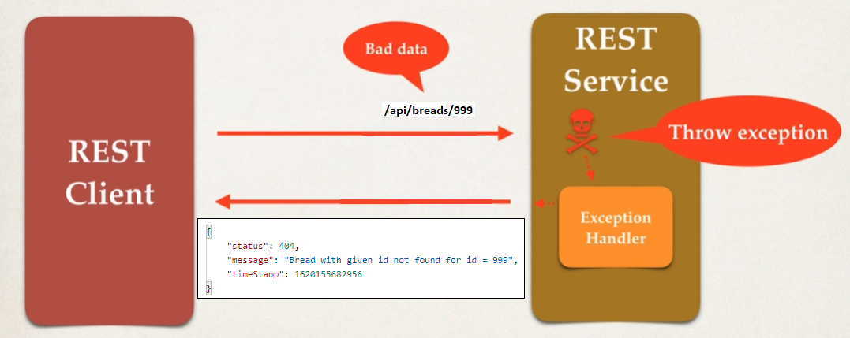
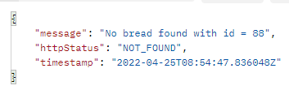
Exception handling
It is possible to further customize the exception thrown and avoid the standard runtime exception.

Slide 25
Exception handling
To fully customize the standard exception, several steps are required:
Create a Custom Exception class
inherits from the RuntimeException-class (ApiRequestException-class)
Create a Custom ExceptionHandler class (ApiExceptionHandler-class)
contains a method that returns a ResponseEntity-object that will return a customized message which is an object of the Custom Response class (see step 3) when an error has occurred.
Create a Custom Response class (ApiExceptionErrorResponse-class)
contains all details of the customized error you want to see in the output-window if an error occurs
Change the controller in order to throw the customized exception

Slide 26
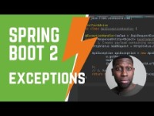
Exception handling
In the video below you see in detail how to make your own Exception Handler in Java Spring Boot:
For your information: for the exams, we will not ask you to implement your own Exception Handler in practice. But you need to know this concept in theory.

